Slide 1
Structure of Crystalline Solids
Instructor:
Prof. Sujoy Kumar Kar

Slide 2
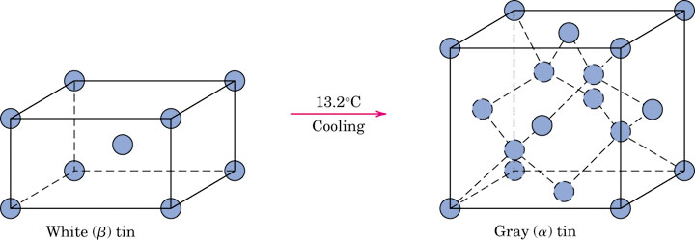
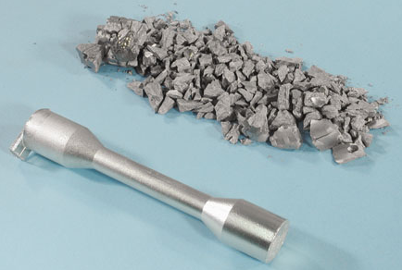
p_pg48
Notes:
p_pg48.jpg

Slide 3
What are we going to discuss?
Concepts of crystallinity and noncrystallinity
Notion of lattice, unit cell, lattice parameters, crystal systems
Labelling conventions (indexing) for points inside unit cell, crystallographic directions and planes
Family of directions and family of planes
Bravais lattices

Slide 4
Crystalline vs. Non-crystalline material
Crystalline material: One in which the atoms/ molecules/ ions are situated in a 3-dimensional repeating or periodic array over large atomic distances
All metals, many ceramic materials, and certain polymers form crystalline structures under normal solidification conditions
Non-crystalline or amorphous materials:
Do not crystallize
Long range atomic order absent

Slide 5
Lattice
An imaginary pattern of points in which every point has an environment that is identical to that of any other point in the pattern.
A lattice has no specific origin
Although it is an imaginary construct, the lattice is used to describe the structure of real materials.

Slide 6
Unit cells
The unit cell is defined as the smallest repeating unit having the full symmetry of the crystal structure
Crystal lattice is built up by repetitive translation of the unit cell along its principal axes)
The unit cell completely defines the symmetry and structure of the entire crystal lattice.
Defines the structure of the crystal lattice by virtue of its geometry and the atom positions within
Parallelepipeds having three sets of parallel faces
Unit cell edges are chosen to be right-handed (a × b is the direction of c)

Slide 7
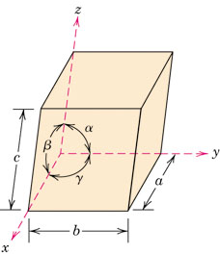
Lattice parameters
The lengths (a, b, and c) of the principal axes, or edges, of the unit cell and the angles between them (α, β, and γ) are the lattice constants, also called lattice parameters.

Slide 8
Crystal Systems
Crystal structure is described in terms of the geometry of arrangement of particles in the unit cell.
Classification of crystals according to unit cell configurations and/or atomic arrangements.
There are seven different possible combinations of a, b, and c, and α, β, and γ, each of which represents a distinct crystal system
Defined in terms of highest symmetry elements present
Cubic
Tetragonal
Orthorhombic
Trigonal
Hexagonal
Monoclinic
Triclinic

Slide 9
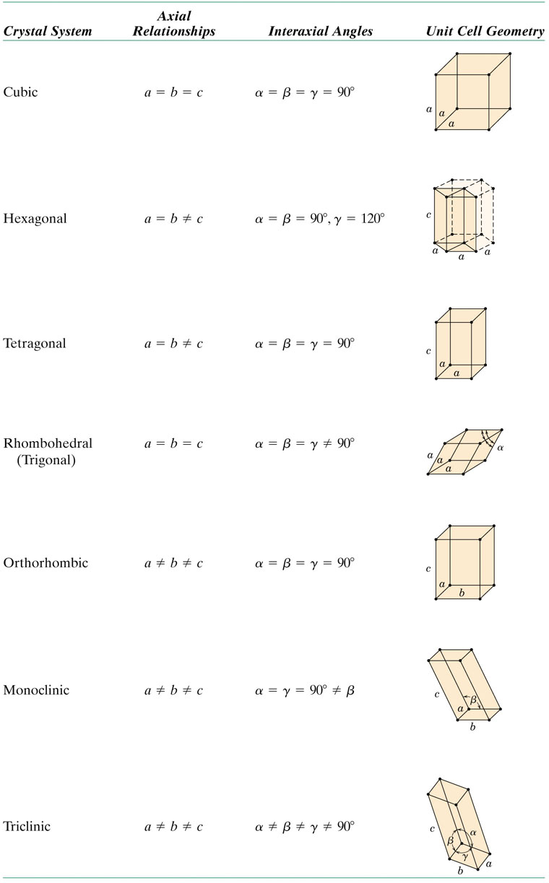
t02_03_pg47
Notes:
t02_03_pg47.jpg

Slide 11
Labeling conventions of crystallographic planes and directions
Three integers or indices are used to designate directions and planes.
The basis for determining index values is the unit cell, with a coordinate system consisting of three (x, y, and z) axes situated at one of the corners and coinciding with the unit cell edges
For hexagonal, rhombohedral, monoclinic, and triclinic—the three axes are not mutually perpendicular

Slide 12
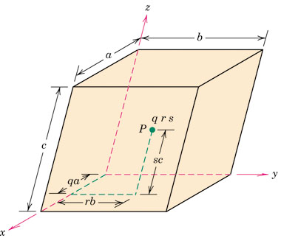
f05_03_pg49
Point Coordinates
Notes:
f05_03_pg49.jpg

Slide 13
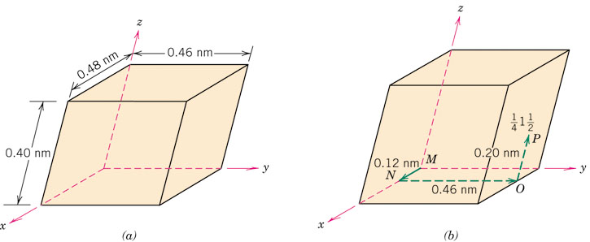
p_pg50
Point Coordinates
Notes:
p_pg50.jpg

Slide 14
Crystallographic Directions
z
Algorithm
1. Vector repositioned (if necessary) to pass
through origin. 2. Read off projections in terms of unit cell dimensions a, b, and c 3. Adjust to smallest integer values (Multiply or divide by a common factor) 4. Enclose in square brackets, no commas
[uvw]
y
x
ex: 1, 0, ½
=> 2, 0, 1
=> [ 201 ]
-1, 1, 1
=>
[ 111 ]
where overbar represents a negative index
Notes:
Lecture 2 ended here

Slide 15
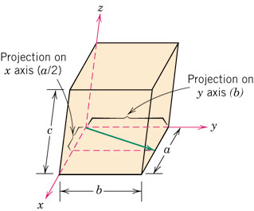
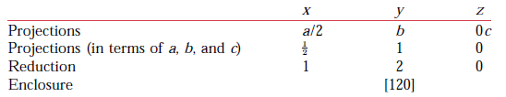
p_pg52
Notes:
p_pg52.jpg

Slide 16
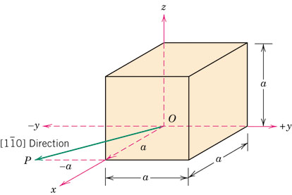
p_pg53
Notes:
p_pg53.jpg

Slide 17
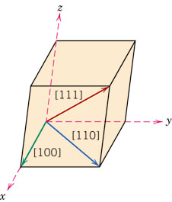
f06_03_pg52
f04_03_pg46
Notes:
f06_03_pg52.jpg

Slide 18
Miller Indices - Directions
c
b
-1
1/2
a
x
1/2
y
-1
z
-1/3
-1/3
(x 6)
1/2
1
x
1
y
1/4
z
1/2
(x 4)
1/4

Slide 19
Equivalent directions
Equivalent directions -- The spacing of atoms along each direction is the same.
In cubic crystals, [100], [100], [010], [010], [001], and [001] are equivalent.
Equivalent directions are grouped together into a family, enclosed in angle brackets, thus: <100>.
Directions in cubic crystals having the same indices without regard to order or sign, for example, [123] and [213], are equivalent.
In general, not true for other crystal systems. In tetragonal crystal system, [100] and [010] directions are equivalent, whereas [100] and [001] are not.

Slide 20
Crystallographic Directions and Planes
All directions and planes are represented in the crystallographic coordinate system.
This is always a right-handed coordinate system based on the unit cell.

Slide 21
Crystallographic Planes
Algorithm
1. If the plane passes through the selected origin, either another parallel plane must be constructed within the unit cell by an appropriate translation or, new origin must be established at the corner of another unit cell. At this point the crystallographic plane either intersects or parallels each of the three axes
2. Read off intercepts of plane with axes in terms of a, b, c
3. Take reciprocals of intercepts
4. Reduce to smallest integer values
5. Enclose in parentheses, no commas i.e., (hkl)
z
example
a b c
c
1. Intercepts
1 1 ∞
2. Reciprocals
1/1 1/1 1/∞
1 1 0
3. Reduction
1 1 0
y
a
b
4. Miller Indices (110)
x

Slide 22
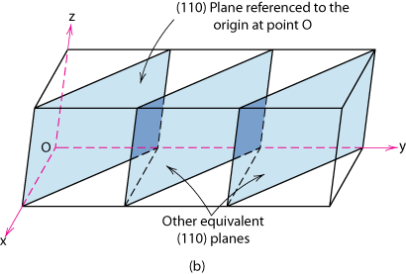
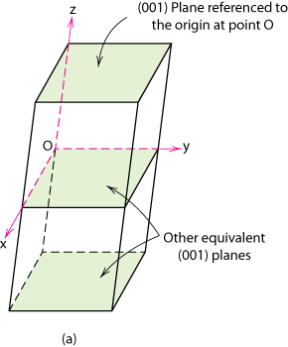
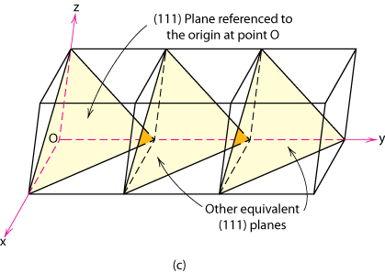
Crystallographic Planes
Any two planes parallel to each other are equivalent and have identical indices

